Slide 1


Slide 2

Welcome to BeeCon!
By Angel Borroy
Jeff Potts
Boriss Mejias
Oksana Kurysheva

Slide 3
Welcome to
Zaragoza

Slide 4

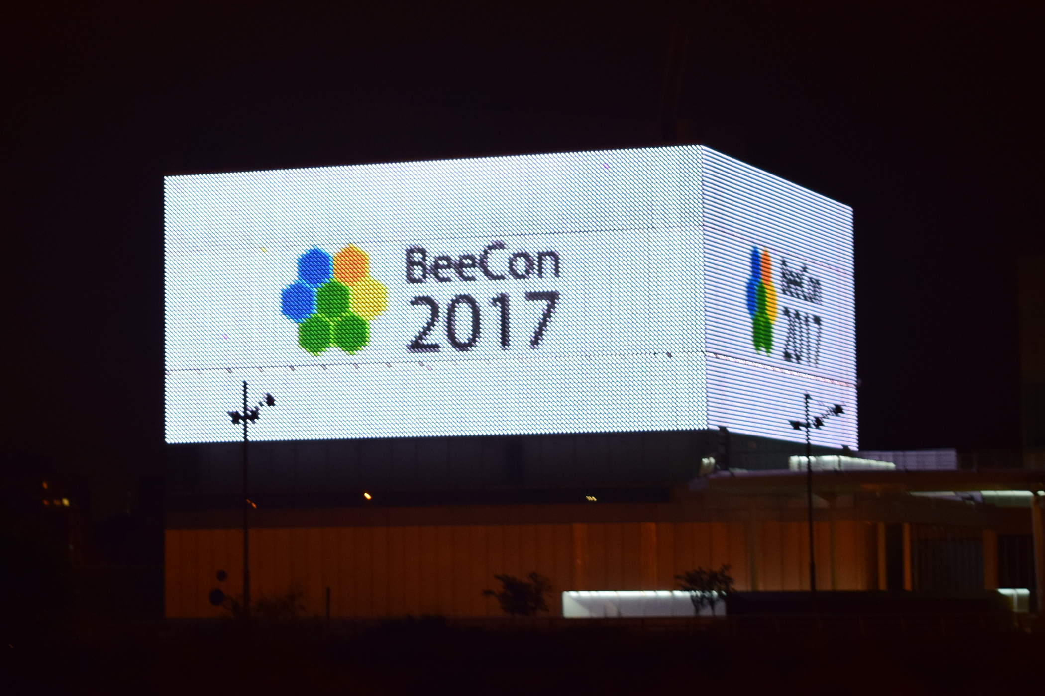

Slide 5
Highlights of
BeeCon

Slide 6

Keynotes & Panels
April 26 9:30 – 10:30
Alfresco Vision
by John Newton
April 26 17:00 – 18:00
Contributing to Alfresco Round 2
by Mark Heath, Richard Esplin, Jeff Potts and Peter Löfgren
April 27 9:00 – 9:45
Power of the Platform
by Thomas de Meo
April 28 12:20 – 13:00
Q&A Alfresco engineers and OOTBee key members

Slide 7
Bird of a Feather sessions
Today
R1: Continuous integration, and test automation
R3: Alfresco clients & UI framework (Future of share, Aikau, ADF …)

Slide 8
Bird of a Feather sessions
Today
R1: Continuous integration, and test automation
R3: Alfresco clients & UI framework (Future of share, Aikau, ADF …)
Tomorrow
R1: Improving the Alfresco social community
R2: Process empowering content flows
R1: Add on development best practices (cross integration projects, cross alfresco version, …)

Slide 9
Jobs Board
Join Jobs board in the hall. Add your vacancies and contacts

Slide 10
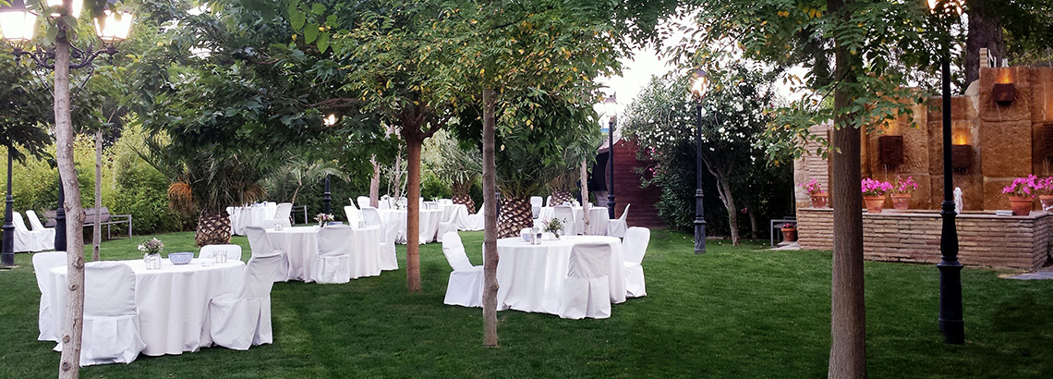

Entertainments
April 26 19:00 – 22:00
Dinner at El Cachirulo
Bus from the venue at 18:45
April 27 19:00 – 22:00 (optional)
“Tapas” walk through the old part of Zaragoza leaded by local fellows of the Order of the Bee. Each one pays his part.
April 28 13:15 – 20:00
Walk in the city with other Bees

Slide 11
We have a couple of changes in the schedule…
So….

Slide 12
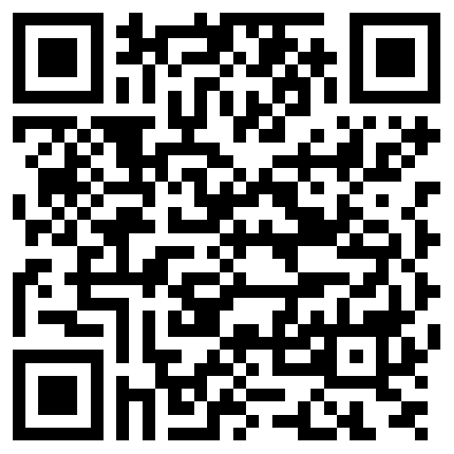
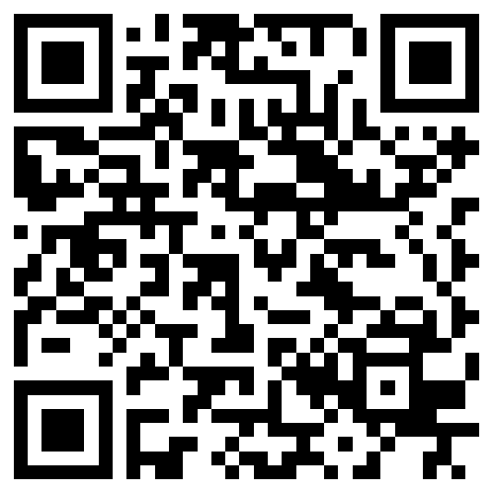
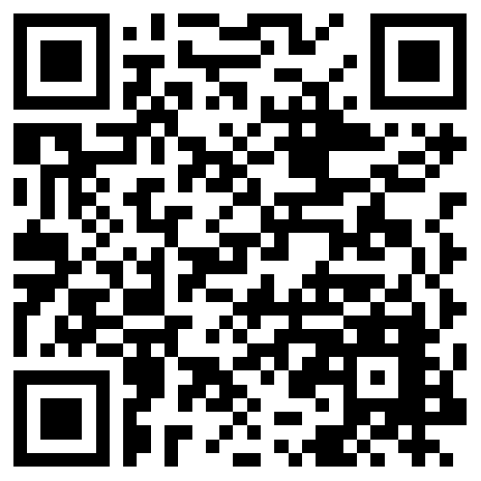

Event Mobile App
Install
Register (you need it to form own agenda and vote for sessions, you can use password qwe123# to make registration easier)
Search for “BeeCon”
Get schedule, speakers, talks files
Google Play
AppStore
Windows Phone

Slide 13
Event Mobile App
Help us to select best Full session (long one) and best lightning talk (5-minutes talk)
Vote for the session you like in the mobile app!

Slide 14
BeeCon Sponsors

Slide 15



Premium Sponsors

Slide 16




General Sponsors

Slide 17
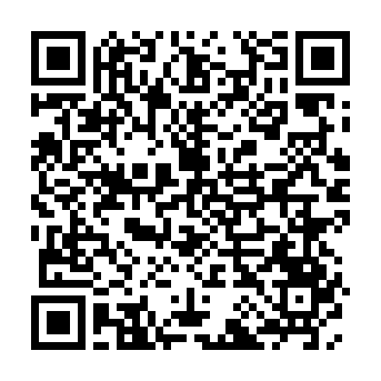

Sponsors activities
Meet Alfresco UX team
Meet Ixxus team tomorrow from 9 till 11 at Room 2

Slide 18
Join our booths!

Slide 19


Organizers

Slide 20
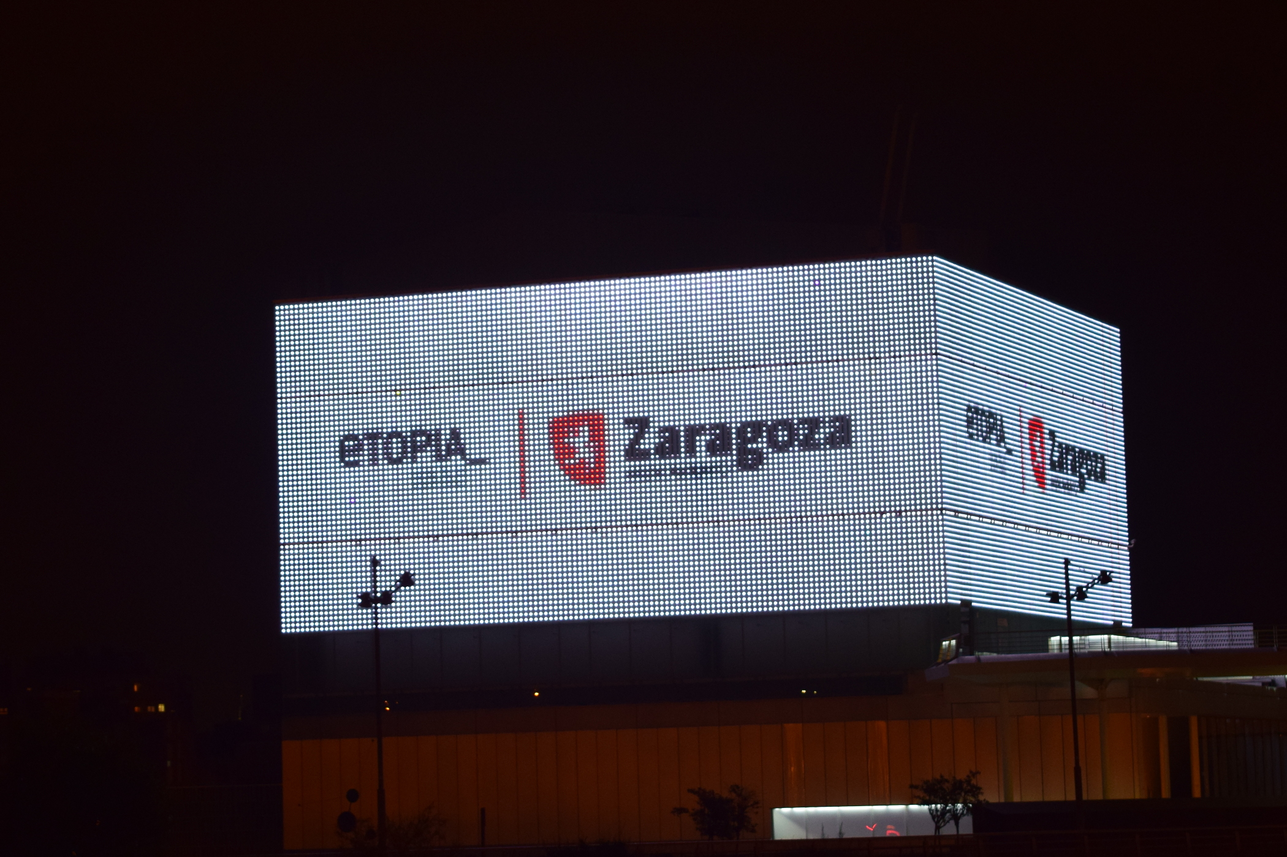

Slide 21
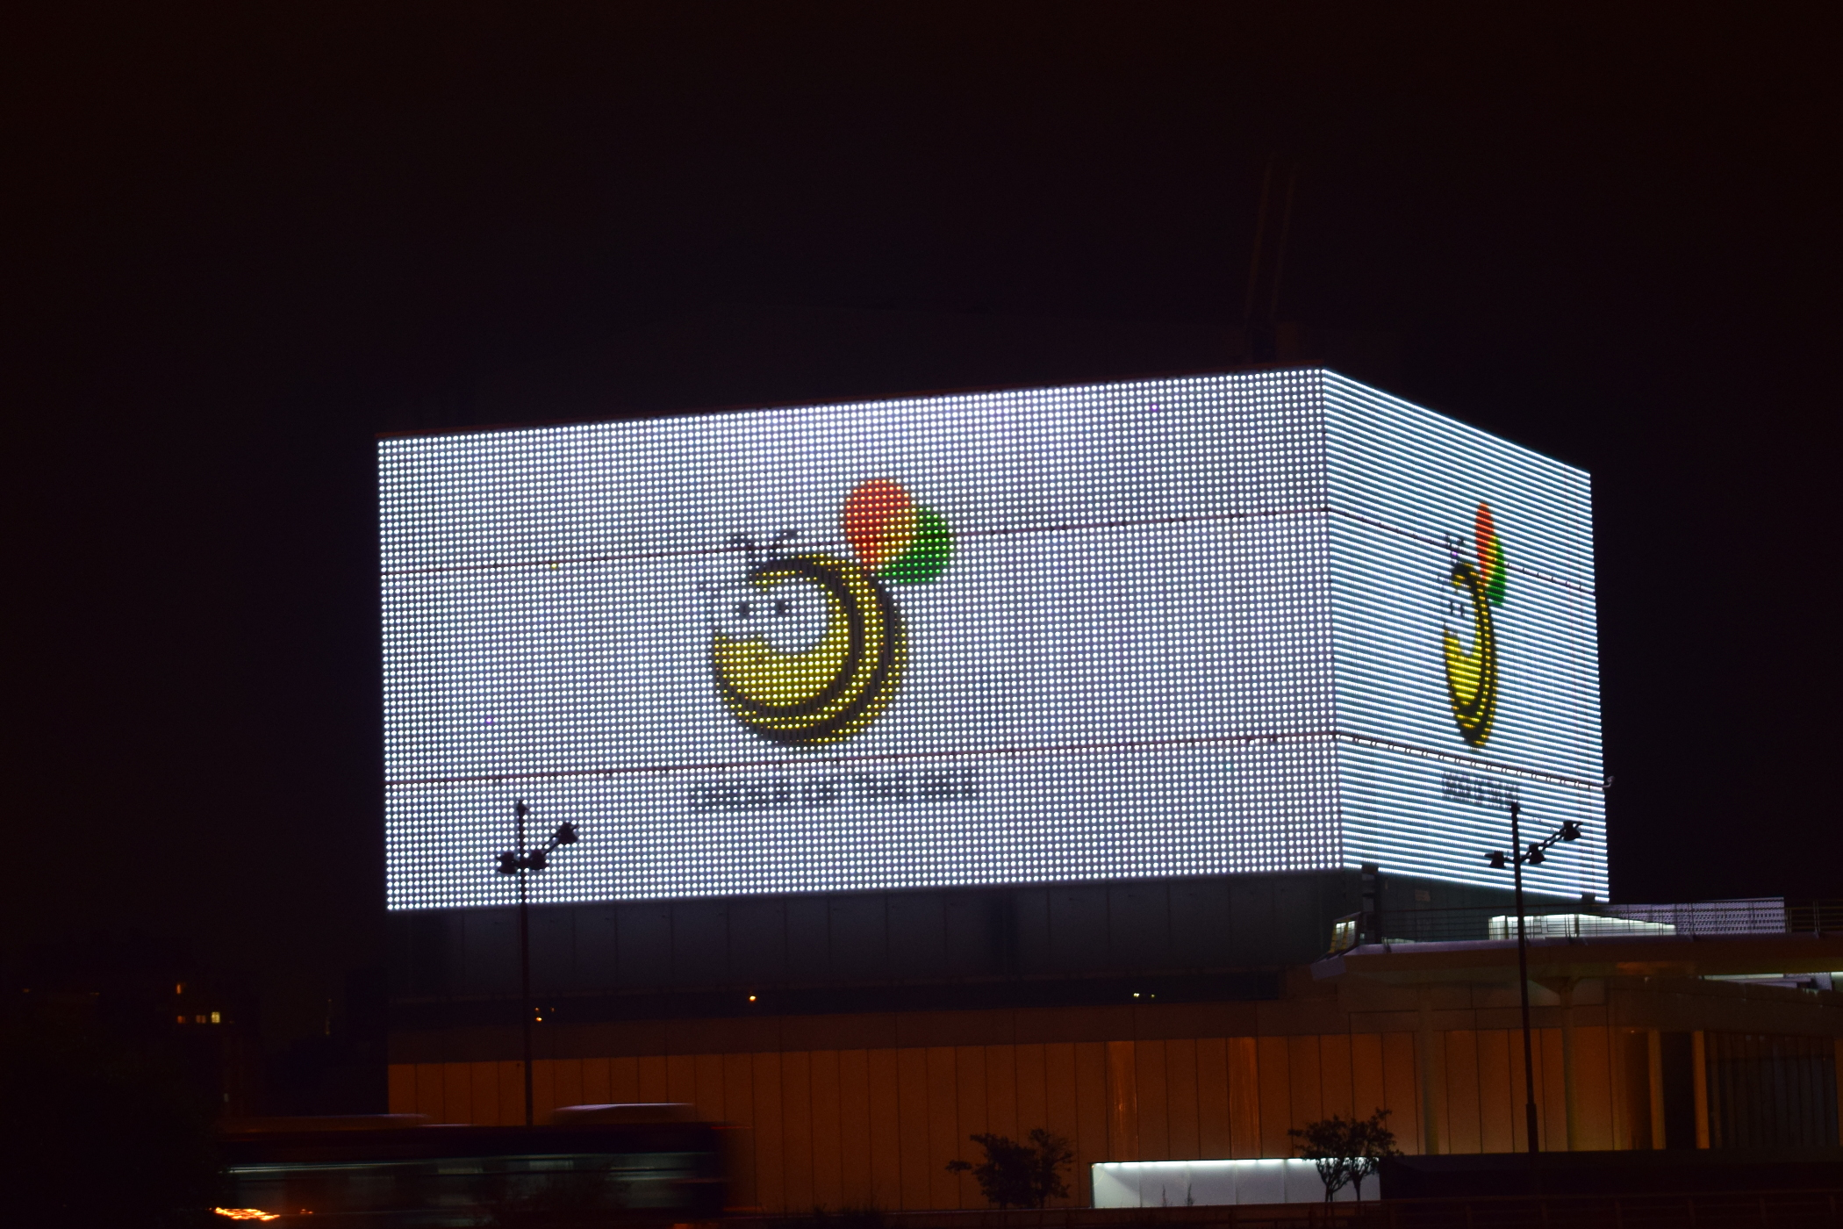

Slide 22
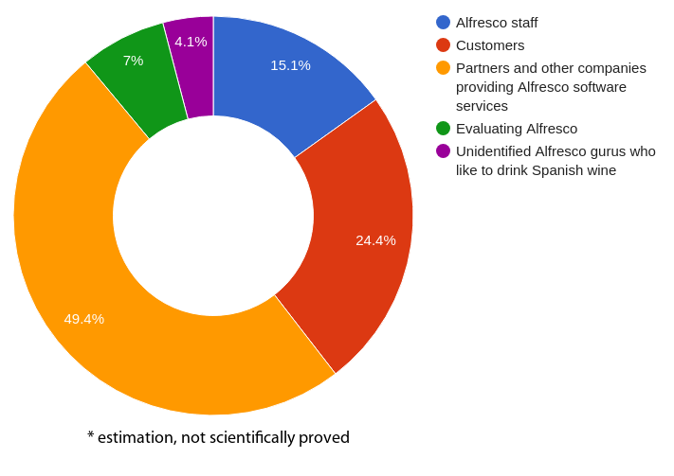
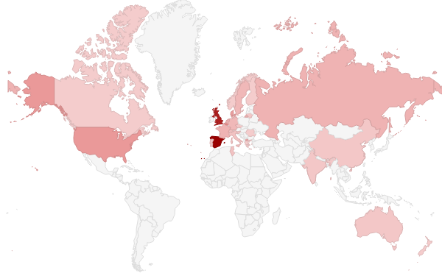
BeeCon 2017 – Who is attending

Slide 23
The BeeCon 2017 Team
Hackathon
Marketing and Sponsors
Alfresco bees
BoF
Program Committee
Local Team
Room hosting

Slide 24
The BeeCon 2017 Team
Hackathon: Axel
Marketing and Sponsors: Oksana the Queen Bee, Cristina
Alfresco bees: Richard, David, Kristen, Francesco
BoF: Younes
Program Committee: Boriss, Younes, David
Local Team: Angel and his colleagues
Room hosting: Vasil, Jeff

Slide 25
The BeeCon 2017 Team
Hackathon: Axel
Marketing and Sponsors: Oksana the Queen Bee, Cristina
Alfresco bees: Richard, David, Kristen, Francesco
BoF: Younes
Program Committee: Core + Fran, Jeff, Douglas and Toni
Local Team: Angel and his colleagues
Room hosting: Vasil, Jeff

Slide 26
The BeeCon 2017 Team
Hackathon: Axel, Angel
Marketing and Sponsors: Oksana the Queen Bee, Cristina, Angel
Alfresco bees: Richard, David, Kristen, Francesco, Angel
BoF: Younes, Angel
Program Committee: Core + Fran, Jeff, Douglas and Toni, Angel
Local Team: Angel and his colleagues
Room hosting: Vasil, Jeff, Angel

Slide 27
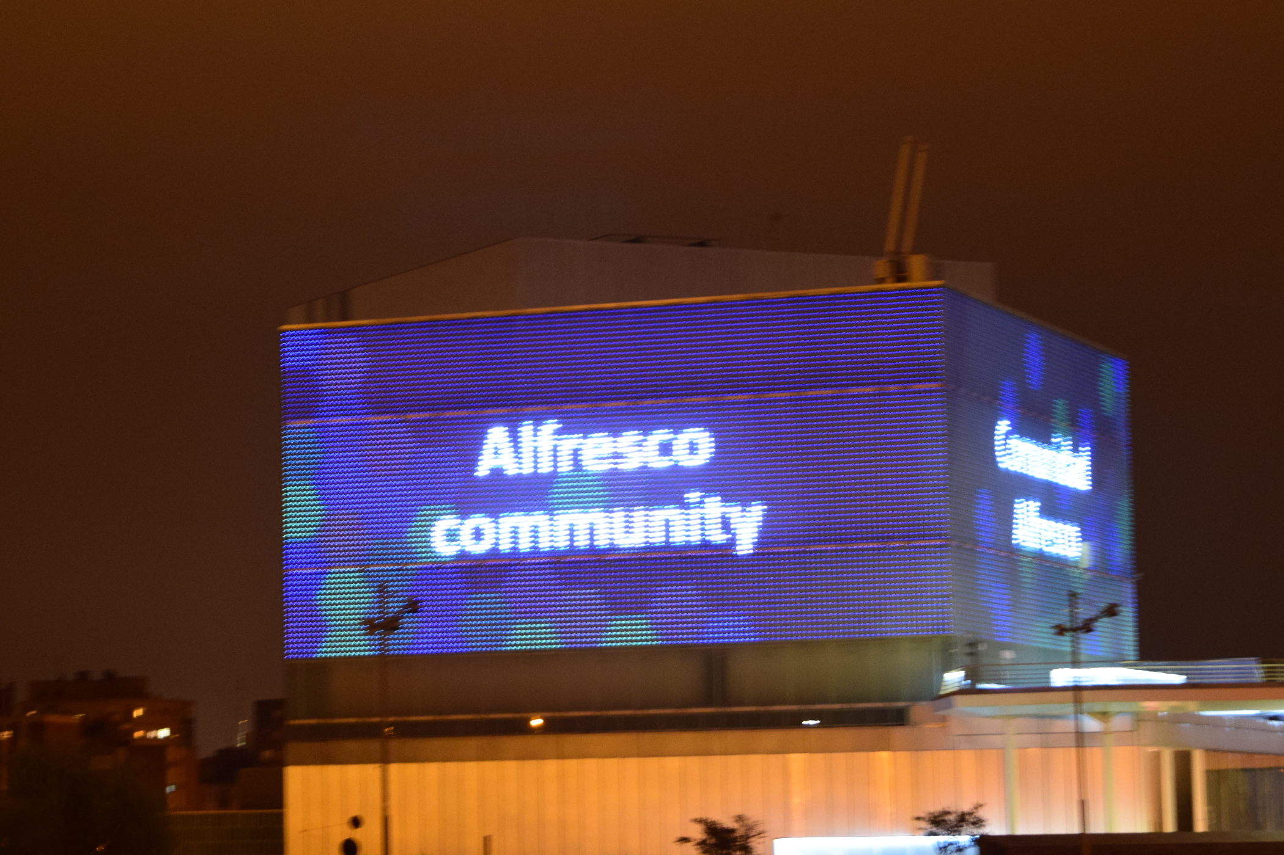

Slide 28


Welcoming other communities
Odoo Community Association
PostgreSQL

Slide 29
Why BeeCon?

Slide 30
A Story
Notes:
A story about expectations

Slide 31
sudo apt-get install Microsoft Flight Simulator
Notes:
My son was having problems with his Linux laptop.
He couldn't get this package to install.

Slide 32
sudo apt-get install microsoft-flight-simulator
Notes:
Even with the spaces removed.
He understood there was a world of software out there
And that it could be installed easily in Linux with apt
But there was some crucial information missing
Led to a great discussion about different software business models.
Ultimately, though, a missed expectation.

Slide 33
sudo apt-get install alfresco
Notes:
What did you expect when you first installed Alfresco?
Back in 2005 I was blown away.
John, John, Paul & the engineering team had just commoditized the ECM industry.
Anyone can start a software company. These guys had the vision to use a commercial open source model.

Slide 34
Anyone can start a software company.
Notes:
What did you expect when you first installed Alfresco?
Back in 2005 I was blown away.
John, John, Paul & the engineering team had just commoditized the ECM industry.
Anyone can start a software company. These guys had the vision to use a commercial open source model.

Slide 35
sudo apt-get install community
Notes:
What was your expectation the first time you engaged with the community?
Maybe it was IRC, the forums, or stackexchange
Any software company can run a forum. It is the people that make the forum helpful, responsive, friendly..

Slide 36
My boss told me to implement ECM with Alfresco. Needs to integrate with ERP. Go live is tomorrow. PLEASE HELP.
Notes:
As long your posts don't look like this.
Of course this isn't very realistic. Usually it's in all caps.

Slide 37
Anyone can run a forum and say they have a community.
Notes:
What was your expectation the first time you engaged with the community?
Maybe it was IRC, the forums, or stackexchange
Any software company can run a forum. It is the people that make the forum helpful, responsive, friendly..

Slide 38
sudo apt-get install beecon
Notes:
What did you expect when you registered for BeeCon?
Latest how-to's. Roadmap & vision. Ideas.
Yes, you will get those.
Any software company can do a marketing event. BeeCon is not that.
People running and attending the conference make the difference.

Slide 39
Anyone can put on a conference.
Notes:
What did you expect when you registered for BeeCon?
Latest how-to's. Roadmap & vision. Ideas.
Yes, you will get those.
Any software company can do a marketing event. BeeCon is not that.
People running and attending the conference make the difference.

Slide 40
Vision
Roadmap
How-to/Insights

Slide 41
Re-connect
Re-charge
Re-commit

Slide 42
Our mission is to guarantee the existence of Alfresco
Community Edition as a free/libre open source solution for document management.
– Order of the Bee

Slide 43
This conference needs you.
This community needs you.
Alfresco needs you.
Notes:
You came a long way to be at this conference.
A lot of work has gone into creating this opportunity for all of us to work together this week, to learn and to brainstorm
This community needs so much from you.
Be present.
Be intentional.
Make a difference.

Slide 44
Be present.
Be intentional.
Make a difference.
Notes:
You came a long way to be at this conference.
A lot of work has gone into creating this opportunity for all of us to work together this week, to learn and to brainstorm
This community needs so much from you.
Be present.
Be intentional.
Make a difference.

Slide 45
What difference will you make?
Notes:
You came a long way to be at this conference.
A lot of work has gone into creating this opportunity for all of us to work together this week, to learn and to brainstorm
This community needs so much from you.
Be present.
Be intentional.
Make a difference.

Slide 46


